Slide 1
Pediatrics and child health
OSCE 3

Slide 2
Down syndrome

Slide 3
Pathogenesis
1)Non disjunction
2. Mosaic Down syndrome only in 1% of cases
3.Translocation Down syndrome….if there is advanced maternal age suspect this one

Slide 4
Clinical Features of Down Syndrome in the Neonatal Period
Central Nervous System
Hypotonia*
Developmental delay
Poor Moro reflex*
Craniofacial
Brachycephaly with flat occiput
Flat face*
Upward slanted palpebral fissures*
Epicanthal folds
Speckled irises (Brushfield spots)
Three fontanels
Delayed fontanel closure
Frontal sinus and midfacial hypoplasia
Mild microcephaly
Short, hard palate
Small nose, flat nasal bridge
Protruding tongue, open mouth
Small dysplastic ears*
Cardiovascular
Endocardial Cushing defects
Ventricular septal defect
Atrial septal defect
Patent ductus arteriosus
Aberrant subclavian artery
Pulmonary hypertension
Musculoskeletal
Joint hyperflexibility*
Short neck, redundant skin*
Short metacarpals and phalanges
Short 5th digit with clinodactyly*

Slide 5
Single transverse palmar creases*
Wide gap between 1st and 2nd toes
Pelvic dysplasia*
Short sternum
Two sternal manubrium ossification centers
Gastrointestinal
Duodenal atresia
Annular pancreas
Tracheoesophageal fistula
Hirschsprung disease
Imperforate anus
Neonatal cholestasis
Cutaneous
Cutis marmorata
*

Slide 6
Hypotonia*
Poor Moro reflex*
Flat face*
Upward slanted palpebral fissures*
Small dysplastic ears*
Joint hyperflexibility
Short neck, redundant skin*
Short 5th digit with clinodactyly*
Single transverse palmar creases*
Pelvic dysplasia*
Hall's criteria to aid in diagnosis.
Presence of the above dysmorphic feature
If #dysmorphic features >8=down syndrome
If #dysmorphic features >5=mosaic down syndrome

Slide 7
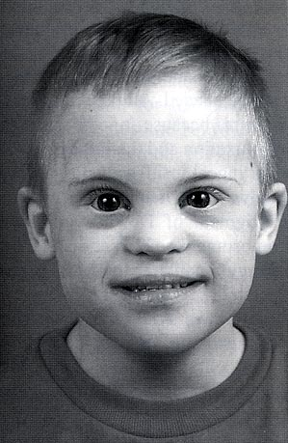
Down syndrome
Facial Characteristics
  Macroglossia
  Micrognathia
  Midface hypoplasia
  Flat occiput
  Flat nasal bridge
  Epicanthal folds
  Up-slanting palpebral fissures
  Progressive enlargement of lips

Slide 8
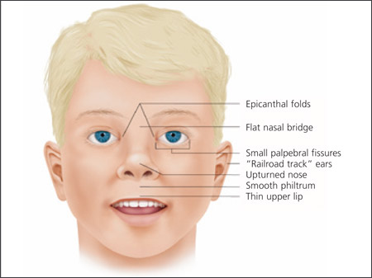

Slide 9
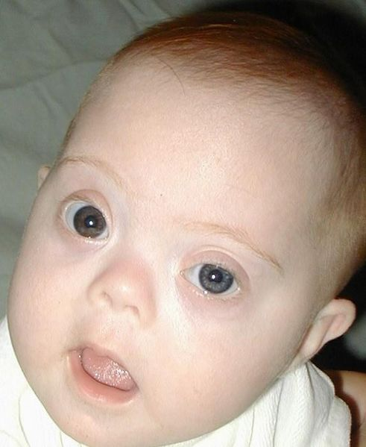
Brushfield spots
small white or grayish/brown spots on the periphery of the iris

Slide 10
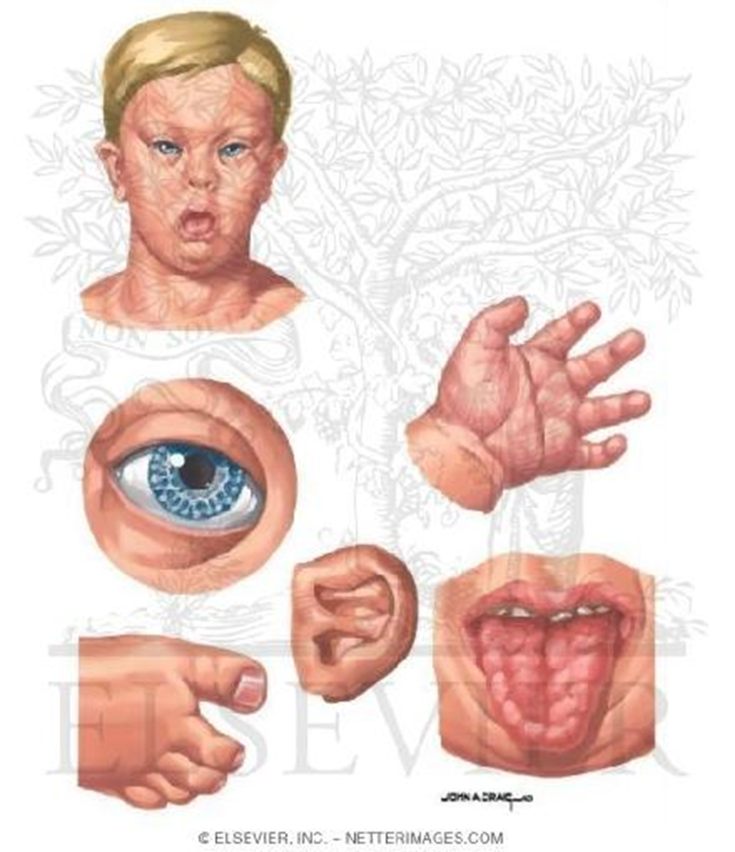
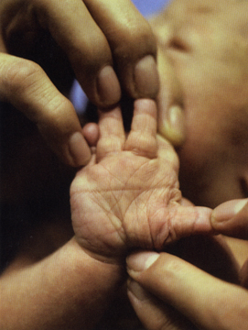
Extremities
Short broad hands
Incurved fifth finger with hypoplastic mid phalanx
Transverse palmar crease
Space between the first
and second toes
(sandal gap)
Hyperflexibility of joints

Slide 11
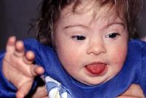
Trisomy 21, Down syndrome

Slide 12
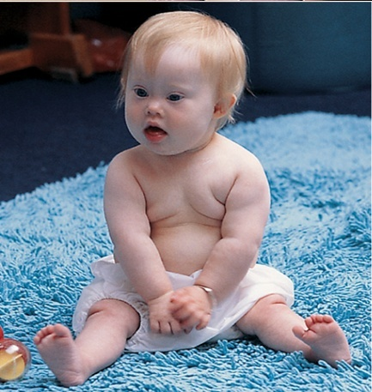
…Trisomy 21, Down syndrome
Hypotonia

Slide 13
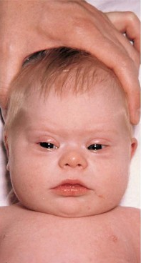
Trisomy 21,
Down syndrome
flat face
upward and slanted palpebral fissures
epicanthic folds
speckled irises (Brushfield spots)
flat nasal bridge
small mouth with protruding tongue
13

Slide 14
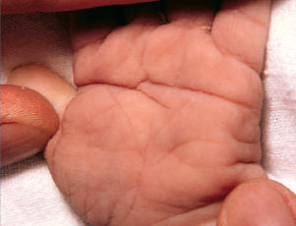
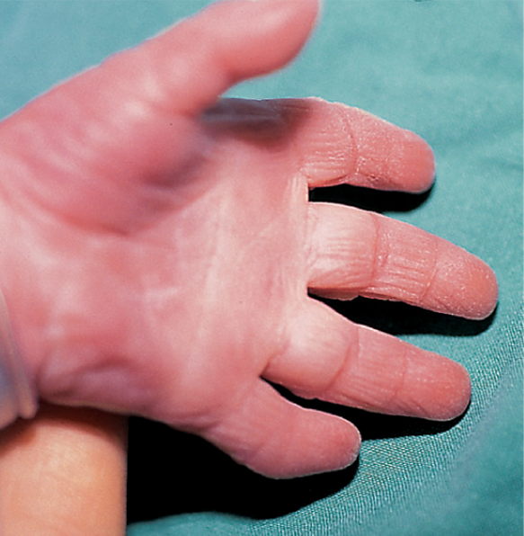
….Trisomy 21, Down syndrome
Single palmar crease, simian crease
short, broad hands
hypoplasia of middle phalanx of 5th finger

Slide 16
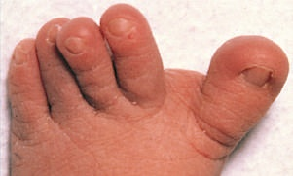
…Trisomy 21, Down syndrome
Pronounced 'sandal' gap between the big and second toe

Slide 17
Marfan Syndrome
Autosomal dominant
  FBN 1 gene encoding extracellular matrix protein – Fibrillin 1
  Traditionally thought problem with elastic fiber deposition (affects aorta, skin)
Occurs 1/5000 – 1/10,000 live births
  30% sporadic d/t new mutations
Primarily affects
  Skeletal
  Cardiovascular
  Ocular

Slide 18
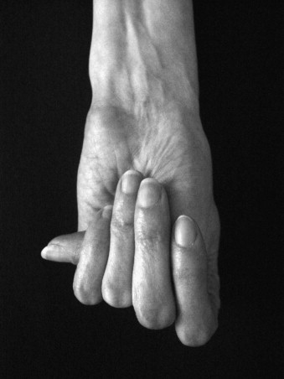
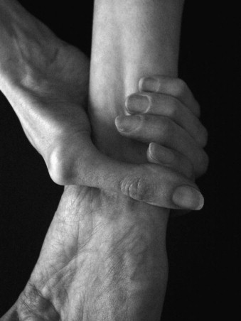
Skeletal system
Scoliosis
Joint laxity and hypermobility – can eventually lead to contractures
Chest deformity (pectus carinatum or excavatum
Long arms
Long fingers and loose joints

Slide 19
Patau’s syndrome

Slide 20
Trisomy 13
Major Clinical Features
mental retardation
growth retardation
microcephaly
cleft lip/palate
small jaw (micrognathia)
deformed, low-set ears
Fingers flexed with postaxial polydactyly
congenital heart defects
seizures
low birth weight
Early lethality in most cases, with a median survival of 7 days; 91% die by 1 year

Slide 21
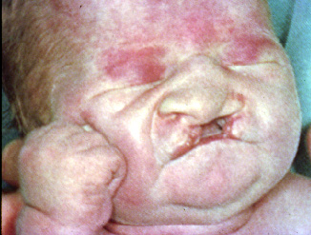
Patau’s syndrome – Trisomy-13

Slide 22
Patau synd…

Slide 23
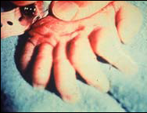
Patau synd…polydactyly

Slide 24
Edward’s syndrome

Slide 25
Trisomy 18 (Edwards)
Major Clinical Features
mental retardation
Low birth weight
Short sternum
Microcephaly
Narrow and dislocated hips/abnormal pelvis
hypertonia
congenital heart disease
horseshoe kidneys
hydronephrosis
short sternum
pyloric stenosis
Most die in utero, otherwise with 1st few days

Slide 26
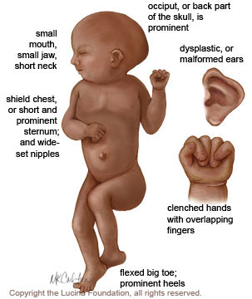
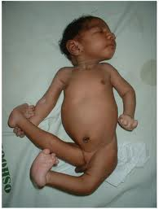
Edwards syndrome - prominent occiput, microcephaly, micrognathia, low-set ears, short sternum, narrow pelvis, prominent calcaneus, and flexion abnormalities of the fingers, congenital heart disease, horseshoe kidney

Slide 27
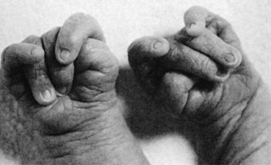
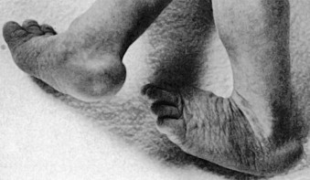
overlapping fingers; index over 3rd, 5th over 4th; closed fist
Rocker bottom feet

Slide 28
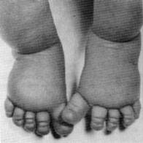
Turner’s Syndrome
Major Clinical Features
Occurs 1/2000-1/5000 females
female phenotype
Short stature (less than 5 feet)
primary amenorrhea
low estrogen levels
maldevelopment of the ovaries
Sterility
Horseshoe kidney
webbing of the skin of the neck
wide-spaced nipples
edema at birth
cardiovascular problems
  Coarctation of aorta
  Bicuspid aortic valve
Hypothyroidism
Diabetes
Lymphadema (swelling of hands and feet)

Slide 29
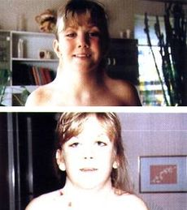
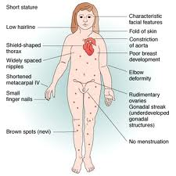
Turner syndrome – clinical features

Slide 30
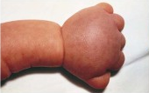
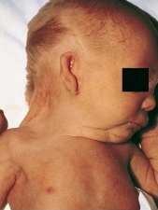
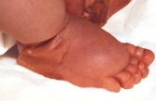
TURNER SYNDROME
CLINICAL MANIFESTATIONS[3]
lymphedema of hands and feet
abnormal ears and
micrognathia

Slide 31
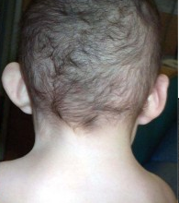
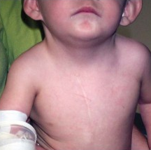
TURNER SYNDROME
CLINICAL MANIFESTATIONS[4]
shield chest with widespread nipples
webbed neck with low hairline

Slide 32
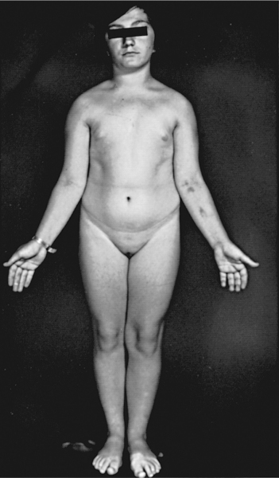
TURNER SYNDROME
CLINICAL MANIFESTATIONS[5]
short stature
cubitus valgus

Slide 33
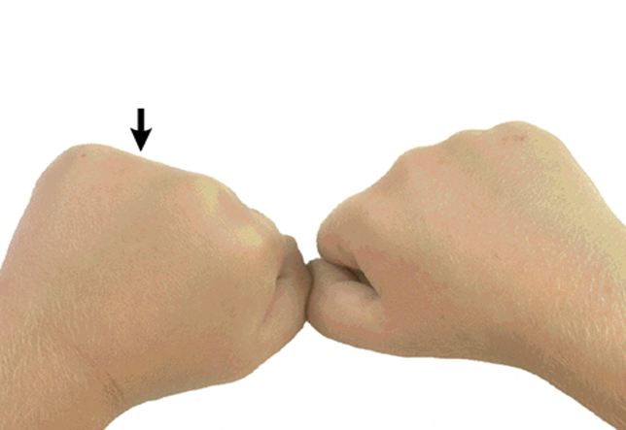
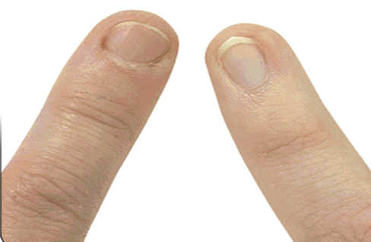
TURNER SYNDROME
CLINICAL MANIFESTATIONS[6]
Short 4th metacarpals
Nail displesia, present in 75%

Slide 34
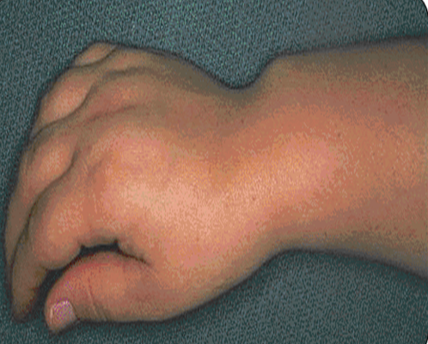
Turner Syndrome
CLINICAL MANIFESTATIONS[7]
Madelung deformity

Slide 35
Klinefelter’s Syndrome
Major Clinical Features
Most common sex chromosomal abnormalities in males (1/500-1/1000)
Rare forms: 48 XXXY
Mosiac 47 XXY, 46 XX
Usually after puberty(if not prenatally)
  do not produce as much testosterone as other boys, they have a less muscular body, less facial and body hair, and broader hips
- Varying mental retardation in some
- Social impairment
- Most have generalized learning disabilities, usually language based
Tend to be tall and slim with long limbs, large hands and feet
Small testes
aspermia (little to no sperm production), Hypogonadism
  fertility in some
Gynecomastia during adolescence

Slide 36
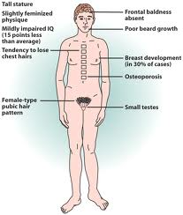
Clinical features cont…
Diagnosis and treatment:
Karyotype of peripheral leukocytes
Testosterone replacement

Slide 37
DiGeorge Syndrome…
Variable hypoplasia of the thymus& parathyroid glands- partial DiGeorge syndrome- More frequent
Total aplasia -- complete DiGeorge syndrome.
15% are born to diabetic mothers.
15% of infants have no identified risk factors.
30% of infants with complete DiGeorge syndrome have CHARGE association .
Clinical features
Children with partial thymic hypoplasia may have little trouble with infections & grow normally.
Patients with complete DiGeorge syndrome resemble patients with SCID in their susceptibility to infections.
Low-grade or opportunistic pathogens:
  Fungi, viruses & Pneumocystis jiroveci
  GVHD from nonirradiated blood transfusions.
RX - Thymic tissue transplants
- Bone marrow or peripheral blood transplantation.

Slide 38
DiGeorge syndrome
Thymic and parathyroid glands hypoplasia
results from dysmorphogenesis of the 3rd and 4th pharyngeal pouches
The classic triad of features of DGS on presentation is
  conotruncal cardiac anomalies
  hypoplastic thymus
  hypocalcemia (resulting from parathyroid hypoplasia)
The dysmorphic features include
  Hypertelorism, antimongloid slant
  Low set notched ears
  short philtrum of the upper lip
  Mandibular hypoplasia
occurs in both males and females
Notes:
The specific cardiac anomalies frequently associated with DGS are
interrupted aortic arch
tetralogy of Fallot
truncus arteriosus

Slide 39
The immune defects in DGS include
  impaired cellular immunity
    CD4+ T-cell count of < 1000 cells/mm3
Boy 14months
Bronchopneumonia ,CHD
Immunodeficiency
Hypocalcemia
Nearside facial paralysis

Slide 40
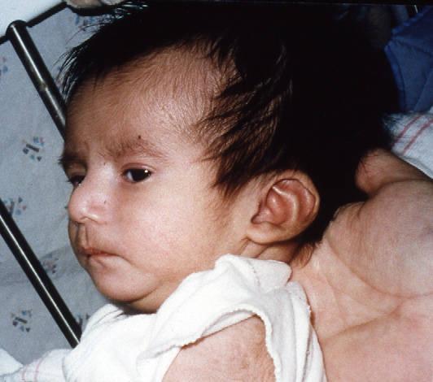
It is critical to confirm the diagnosis of complete DGS
Because it is fatal without treatment.
The diagnosis is 1st suggested by hypocalcemic seizures during the neonatal period
Treatment
    Bone marrow transplantation.

Slide 41
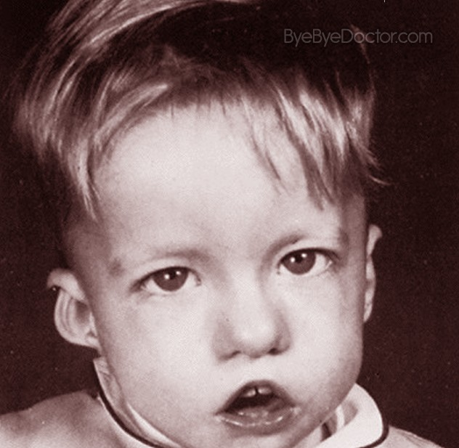
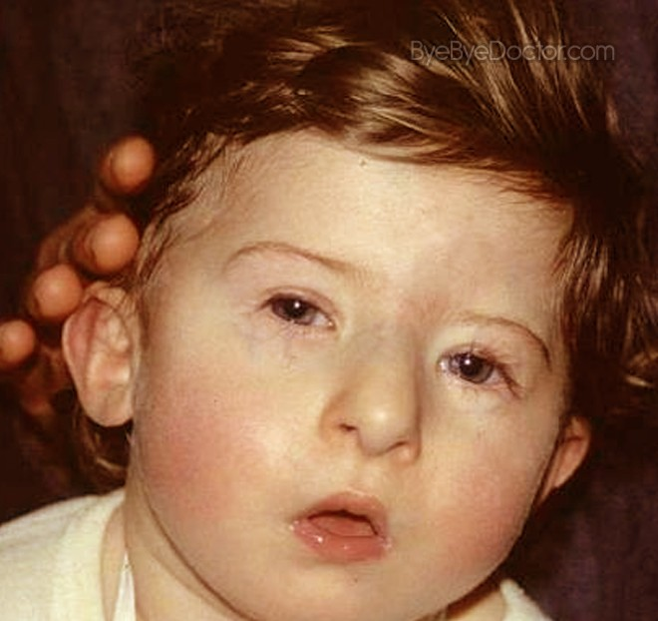

Slide 42
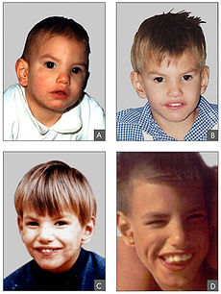
Cri du chat
Major Clinical Features
Distinctive cat-like cry 1st few weeks of life
Profound developmental retardation
Severe mental retardation
Microcephaly
Hypotonia
Hypertelorism
Epicanthal folds
High arched palate
Wide and flat nasal bridge

Slide 43
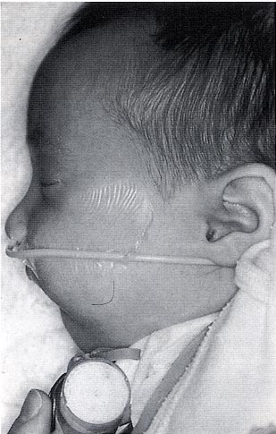
Pierre Robin Sequence
Triad of cleft palate, micrognathia, and glossoptosis (airway obstruction caused by backwards dsplacement of the tongue base)
1923, credit to French stomatologist
Incidence 1 in 8500

Slide 44
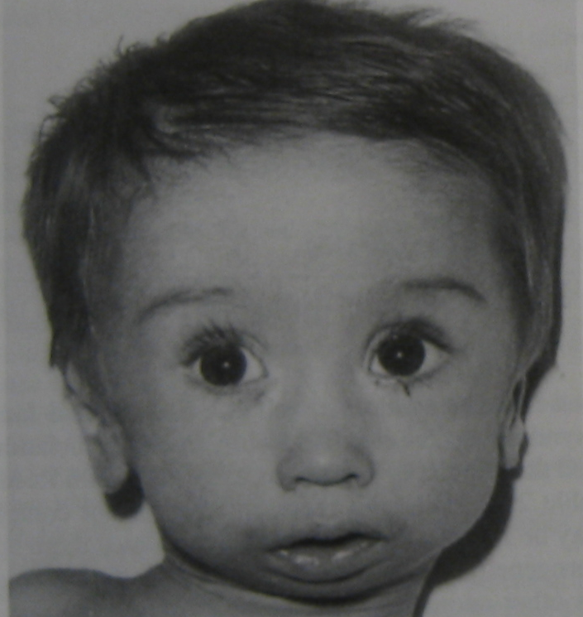
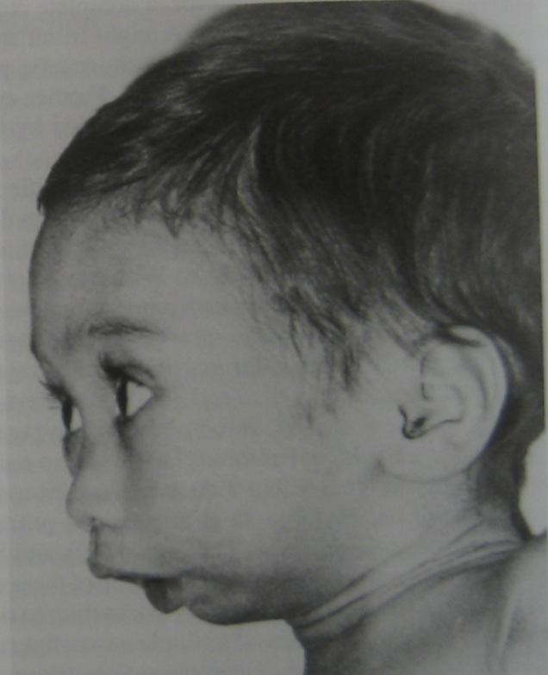
PRS
Pictures From: Gorlin et al: Syndromes of the Head and Neck. New York, Oxford University Press, 1990.

Slide 45
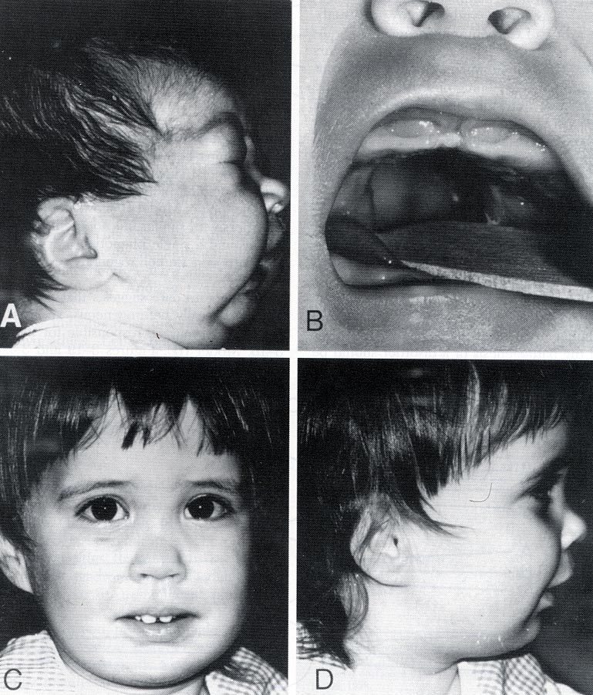
PRS (cont.)
Mandibular deficiency
Etiology can be multiple (positional, genetic, neurologic, connective tissue d/o)
Nonsyndromic (80%) or syndromic (20%)

Slide 46
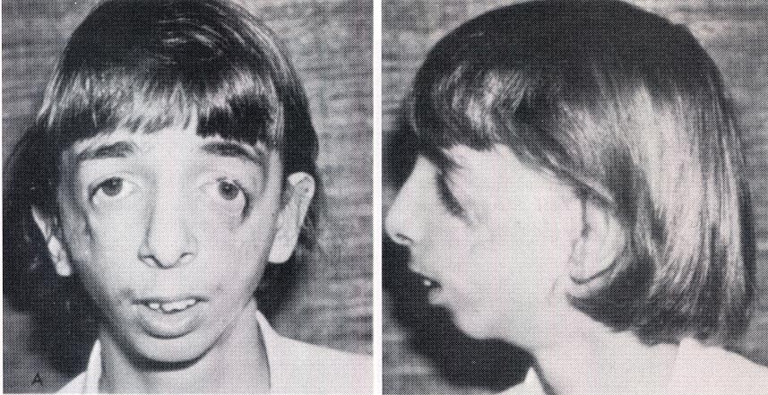
Treacher-Collins Syndrome
Autosomal dominant
1 in 25,000 –50,000 births
Bilateral abnormalities of 1st and 2nd branchial arches
Hypoplasia of maxilla, zygoma, and mandible
Downward slanting eyes with colobomas of lower eyelid and absence of eyelashes
Normal intelligence

Slide 47
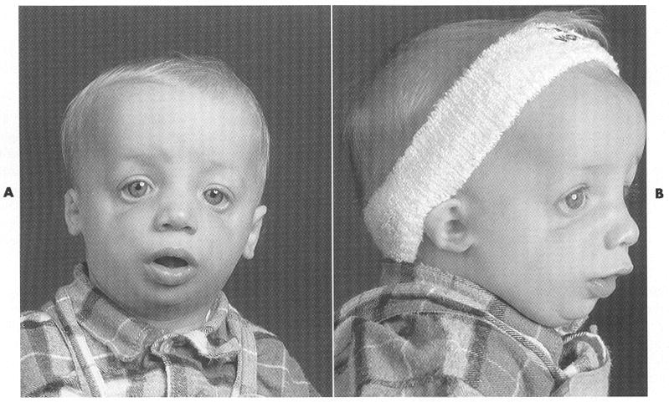
TCS
Picture From: Cummings, CW: Otolaryngology: Head and Neck Surgery. St Louis, Mosby, 1998

Slide 48
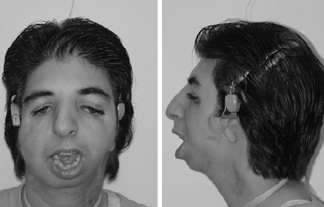
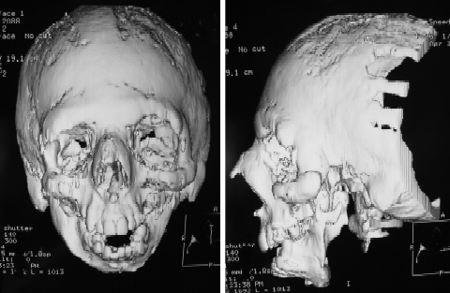
TCS
Picture From: Acosta, HL et al: Vertical Mesenchymal Distraction and Bilateral Free Fibula Transfer for Severe Treacher Collins Syndrome. Plastic & Reconstructive Surgery, 113(4), 2004.

Slide 49
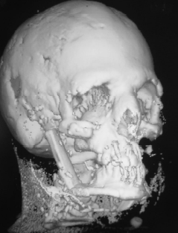
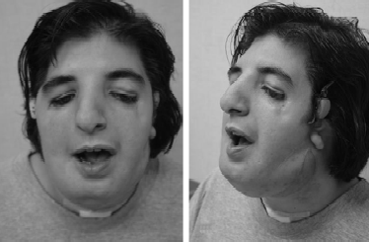
TC.
Picture From: Acosta, HL et al: Vertical Mesenchymal Distraction and Bilateral Free Fibula Transfer for Severe Treacher Collins Syndrome. Plastic & Reconstructive Surgery, 113(4), 2004.

